Slide 1
MGB235 Monitoring and Managing Operational Performance
Week 6: Capacity Planning, Facilities Design & Location Planning
Dr Kavoos Mohannak

Slide 2
Lecture Outline
Strategic Capacity Planning
Facilities Design
Basic Layouts
Designing Process Layouts
Designing Service Layouts
Designing Product Layouts
Combination (Hybrid) Layouts
Location planning

Slide 3
Capacity
Maximum capability to produce
The upper limit or ceiling on the load that an operating unit can handle
Capacity needs include
Equipment
Space
Employee skills
Key questions:
What kind of capacity is needed?
How much is needed to match demand?
When is it needed?

Slide 4
Capacity Decisions Are Strategic
Capacity decisions
Impact the ability of the organization to meet future demands
Affect operating costs
Are a major determinant of initial cost
Often involve long-term commitment of resources
Can affect competitiveness
Affect the ease of management
Have become more important and complex due to globalization
Need to be planned for in advance due to their consumption of financial and other resources
Copyright ©2021 McGraw-Hill Education. All rights reserved. No reproduction or distribution without the prior written consent of McGraw-Hill Education.
5-4

Slide 5
Strategic Capacity Planning
Goal
To achieve a match between the long-term supply capabilities of an organization and the predicted level of long-term demand
Overcapacity → operating costs that are too high
Undercapacity → strained resources and possible loss of customers
3 basic strategies for timing of capacity expansion in relation to steady growth in demand (lead, lag, and average)
Copyright ©2021 McGraw-Hill Education. All rights reserved. No reproduction or distribution without the prior written consent of McGraw-Hill Education.
5-5

Slide 6
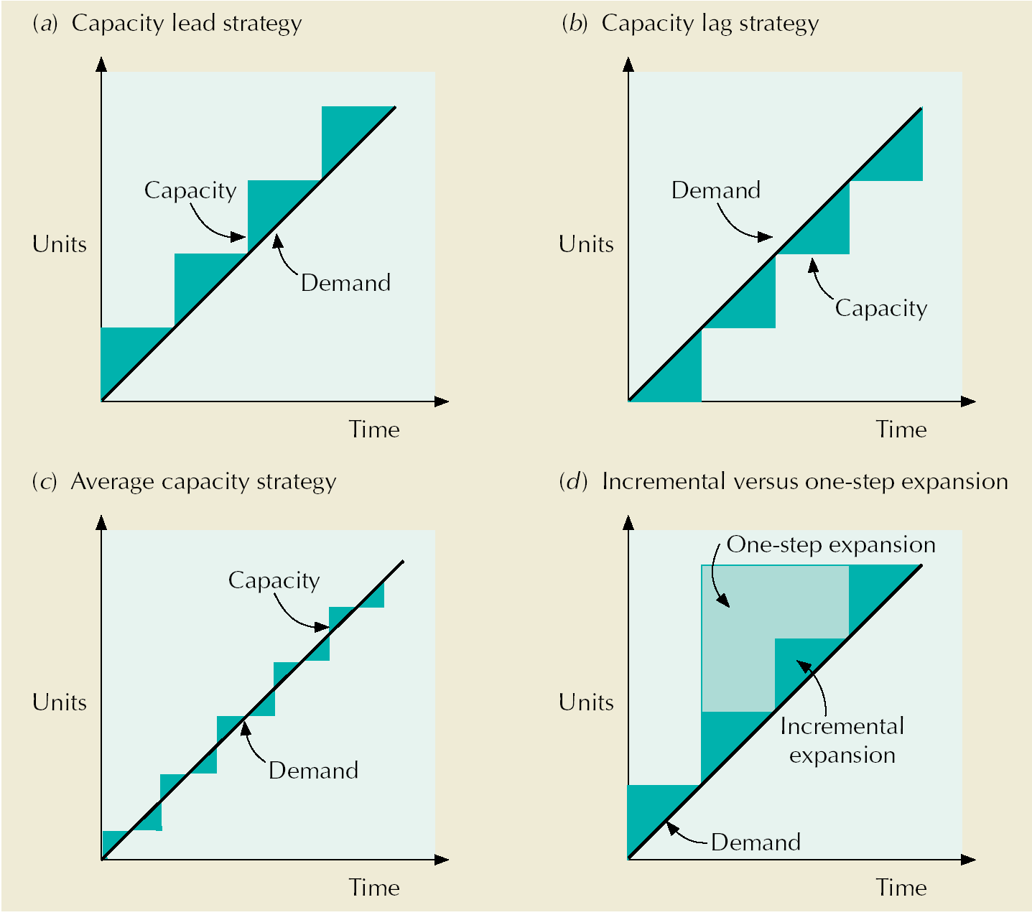
Capacity Expansion Strategies
Notes:
Text, p.261

Slide 7
Measuring Capacity
Two useful definitions of capacity
Design capacity
The maximum output rate or service capacity an operation, process, or facility is designed for
Effective capacity
Design capacity minus allowances such as personal time and maintenance
Copyright ©2021 McGraw-Hill Education. All rights reserved. No reproduction or distribution without the prior written consent of McGraw-Hill Education.
5-7

Slide 8
Measures of capacity
Business | Inputs | Outputs
Auto manufacturing | Labor hours, machine hours | Number of cars per shift
Steel mill | Furnace size | Tons of steel per day
Oil refinery | Refinery size | Gallons of fuel per day
Farming | Number of acres, number of cows | Bushels of grain per acre per year, gallons of milk per day
Restaurant | Number of tables, seating capacity | Number of meals served per day
Theater | Number of seats | Number of tickets sold per performance
Retail sales | Square feet of floor space | Revenue generated per day
Copyright ©2021 McGraw-Hill Education. All rights reserved. No reproduction or distribution without the prior written consent of McGraw-Hill Education.
5-8

Slide 9
Measuring System Effectiveness
Actual output
The rate of output actually achieved
It cannot exceed effective capacity
Efficiency
Utilization
Measured as percentages
Copyright ©2021 McGraw-Hill Education. All rights reserved. No reproduction or distribution without the prior written consent of McGraw-Hill Education.
5-9

Slide 10
Example – Efficiency and Utilization
Design Capacity = 50 trucks per day
Effective Capacity = 40 trucks per day
Actual Output = 36 trucks per day
Copyright ©2021 McGraw-Hill Education. All rights reserved. No reproduction or distribution without the prior written consent of McGraw-Hill Education.
5-10

Slide 11
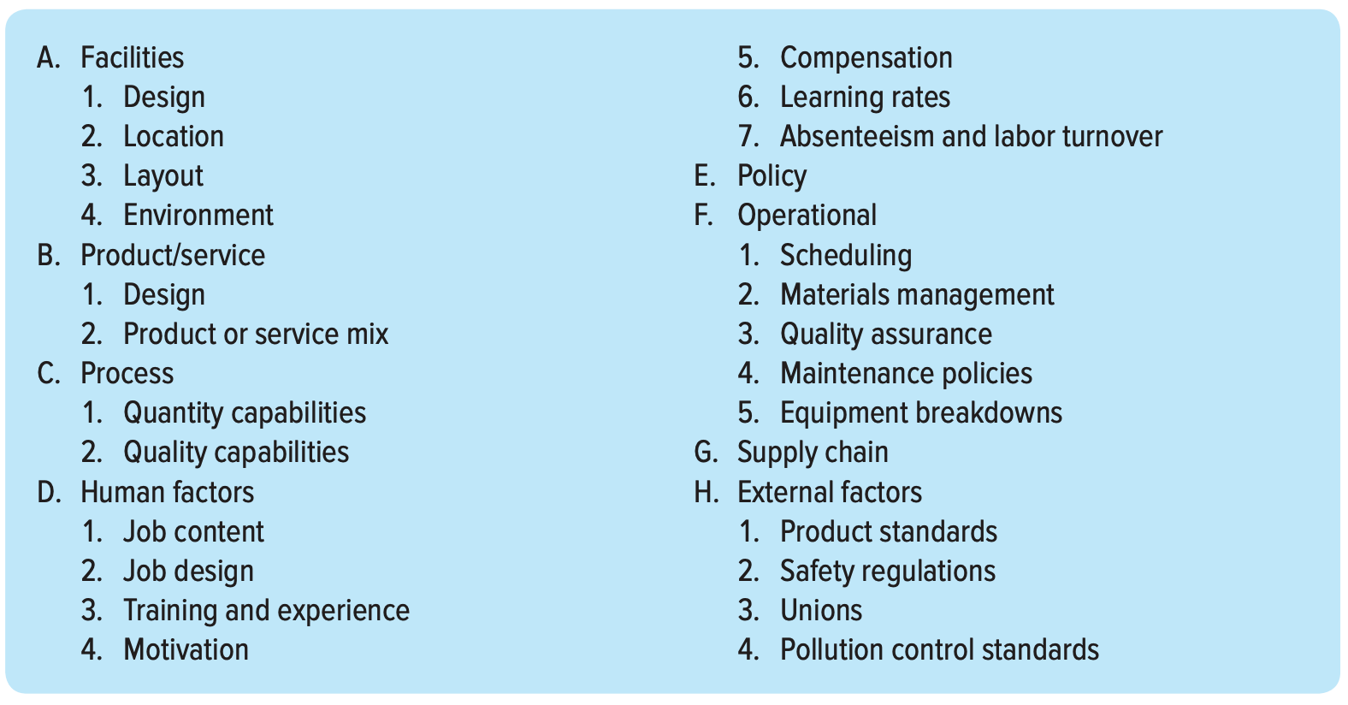
Factors that determine effective capacity
Copyright ©2021 McGraw-Hill Education. All rights reserved. No reproduction or distribution without the prior written consent of McGraw-Hill Education.
5-11

Slide 12
Capacity
Capacity increase depends on
volume and certainty of anticipated demand
strategic objectives
costs of expansion and operation
Best operating level
% of capacity utilization that minimizes unit costs
Capacity cushion
% of capacity held in reserve for unexpected occurrences
Capacity cushion strategy
Organizations that have greater demand uncertainty typically have greater capacity cushions
Organizations that have standard products and services generally have smaller capacity cushions

Slide 13
Economies of Scale
Unit cost decreases as output volume increases
fixed costs can be spread over a larger number of units
production or operating costs do not increase linearly with output levels
quantity discounts are available for material purchases
operating efficiency increases as workers gain experience

Slide 14
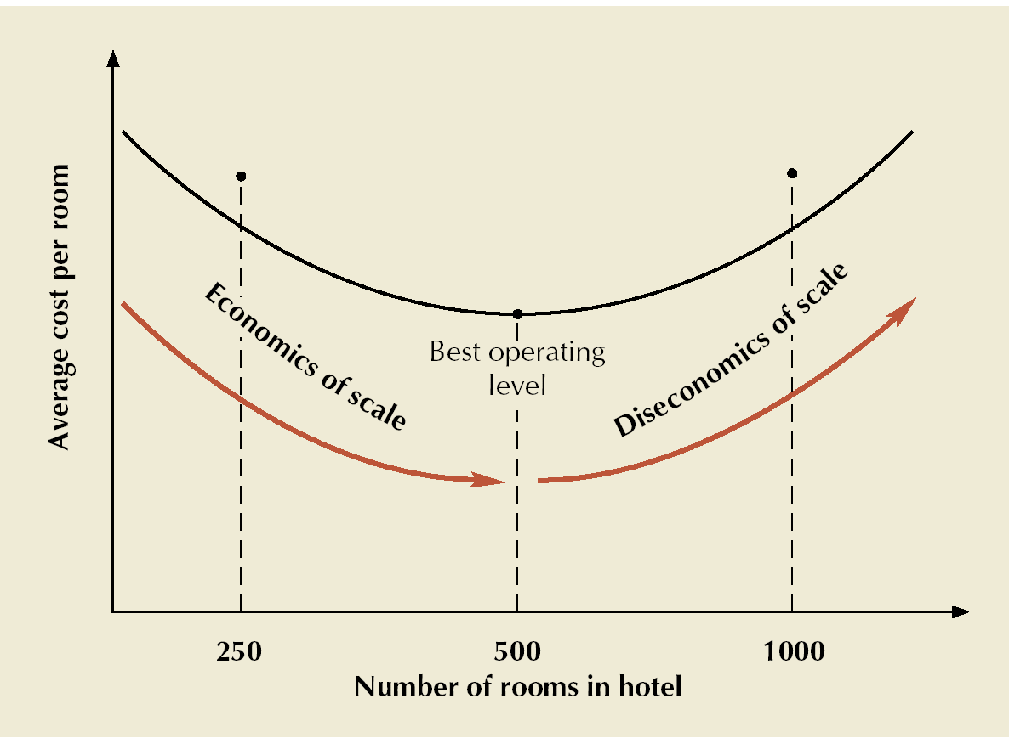
Best Operating Level for a Hotel
Notes:
Text p.262

Slide 15
Objectives of Facility Layout:
Facility layout design: the arrangement of areas within a facility – involves multiple objectives as well as affecting quality and competitiveness
Minimize material-handling costs
Utilize space efficiently
Utilize labor efficiently
Eliminate bottlenecks
Facilitate communication and interaction
Reduce manufacturing cycle time
Reduce customer service time
Eliminate wasted or redundant movement

Slide 16
Objectives of Facility Layout
Facilitate entry, exit, and placement of material, products, and people
Incorporate safety and security measures
Promote product and service quality
Encourage proper maintenance activities
Provide a visual control of activities
Provide flexibility to adapt to changing conditions
Increase capacity

Slide 17
Basic Layouts
Process layouts
group similar activities together according to process or function they perform
Product layouts
arrange activities in line according to sequence of operations for a particular product or service
Fixed-position layouts
are used for projects in which product cannot be moved
Combination (hybrid) layouts

Slide 18
Process Layout in Services
Women’s lingerie
Shoes
Housewares
Women’s dresses
Cosmetics and jewelry
Children’s department
Women’s sportswear
Entry and display area
Men’s department
Notes:
p265

Slide 19
Comparison of Product and Process Layouts
Product
Process
Description
Type of process
Product
Demand
Volume
Equipment
Sequential arrangement of activities
Continuous, mass production, mainly assembly
Standardized, made to stock
Stable
High
Special purpose
Functional grouping of activities
Intermittent, job shop, batch production, mainly fabrication
Varied, made to order
Fluctuating
Low
General purpose

Slide 20
Comparison of Product and Process Layouts
Product
Process
Workers
Inventory
Storage space
Material handling
Aisles
Scheduling
Layout decision
Goal
Advantage
Limited skills
Low in-process, high finished goods
Small
Fixed path (conveyor)
Narrow
Part of balancing
Line balancing
Equalize work at each station
Efficiency
Varied skills
High in-process, low finished goods
Large
Variable path (forklift)
Wide
Dynamic
Machine location
Minimize material handling cost
Flexibility

Slide 21
Fixed-Position Layouts
Typical of projects
Fragile, bulky, heavy items
Equipment, workers & materials brought to site
Low equipment utilization
Highly skilled labor
Typically low fixed cost
Often high variable costs

Slide 22
Designing Process Layouts
Goal: minimize material handling costs
Block Diagramming
minimize nonadjacent loads
use when quantitative data is available
Relationship Diagramming
based on location preference between areas
use when quantitative data is not available

Slide 23
Designing Service Layouts
Must be both attractive and functional
Free flow layouts
encourage browsing, increase impulse purchasing, are flexible and visually appealing
Grid layouts
encourage customer familiarity, are low cost, easy to clean and secure, and good for repeat customers
Loop and Spine layouts
both increase customer sightlines and exposure to products, while encouraging customer to circulate through the entire store

Slide 24
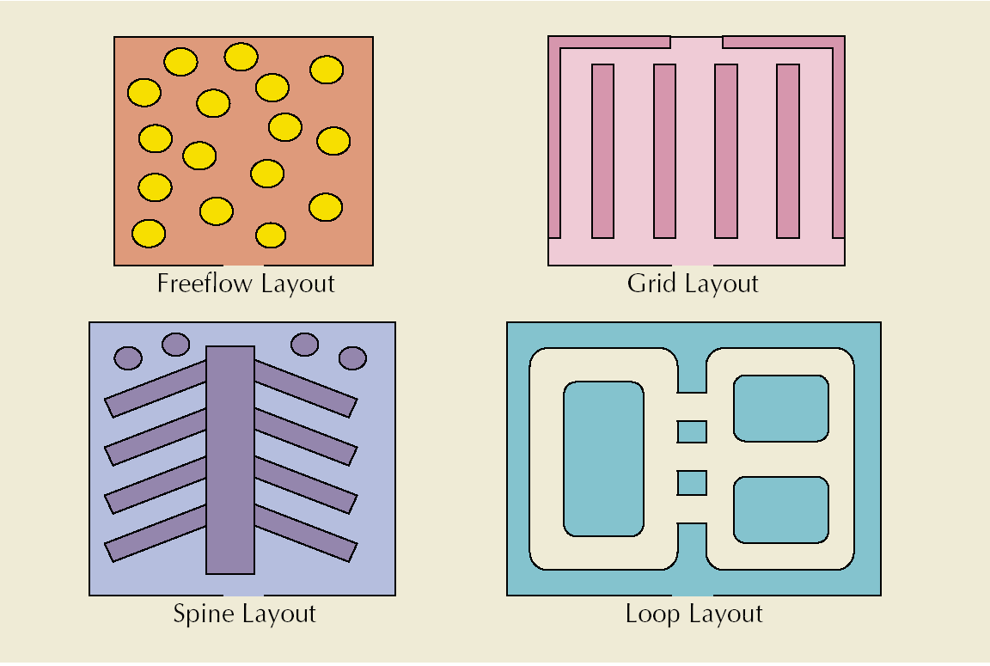
Types of Store Layouts

Slide 25
Designing Product Layouts
Objective
Balance the assembly line
Line balancing
tries to equalize the amount of work at each workstation
Precedence requirements
physical restrictions on the order in which operations are performed
Cycle time
maximum amount of time a product is allowed to spend at each workstation

Slide 26
Repetitive Processing: Product Layouts
Product layout
Layout that uses standardized processing operations to achieve smooth, rapid, high-volume flow
Raw materials
or customer
Station
1
Station
2
Station
3
Station
4
Finished item
Material
and/or labor
Material
and/or labor
Material
and/or labor
Material
and/or labor
Used for Repetitive Processing
Repetitive or Continuous
Copyright ©2021 McGraw-Hill Education. All rights reserved. No reproduction or distribution without the prior written consent of McGraw-Hill Education.

Slide 27
Combination (Hybrid) Layouts
Some operational environments use a combination of the three basic layout types: e.g. Hospitals, Supermarket, Shipyards
Cellular layouts
group dissimilar machines into work centers (called cells) that process families of parts with similar shapes or processing requirements
Flexible manufacturing system
automated machining and material handling systems which can produce an enormous variety of items
Mixed-model assembly line
processes more than one product model in one line

Slide 28
Location Planning
Types of Facilities:
Heavy-manufacturing facilities
large, require a lot of space, and are expensive
Light-industry facilities
smaller, cleaner plants and usually less costly
Retail and service facilities
smallest and least costly

Slide 29
Location Decision: General Procedure
Steps:
Decide on the criteria to use for evaluating location alternatives
Identify important factors, such as location of markets or raw materials
Develop location alternatives
Identify the country or countries for location
Identify the general region for location
Identify a small number of community alternatives
Identify the site alternatives among the community alternatives
Evaluate the alternatives and make a decision
Copyright ©2021 McGraw-Hill Education. All rights reserved. No reproduction or distribution without the prior written consent of McGraw-Hill Education.
8-29

Slide 30
Factors in Heavy Manufacturing Location
Construction costs
Land costs
Raw material & finished goods shipment modes
Proximity to raw materials (suppliers)
Utilities
Means of waste disposal
Labor availability

Slide 31
Factors in Light Industry Location
Land costs
Transportation costs
Proximity to markets
depending on delivery requirements including frequency of delivery required by customer

Slide 32
Factors Relating to Foreign Locations
Government | Policies on foreign ownership of production facilities Local content requirements Import restrictions Currency restrictions Environment regulations Local product standards Liability laws b. Stability issues
Cultural differences | Living circumstances for foreign workers and their dependents Ways of doing business Religious holidays/traditions
Customer preferences | Possible “buy locally” sentiment
Labor | Level of training and education of workers Work ethic Wage rates Possible regulations limiting the number of foreign employees Language differences
Resources | Availability and quality of raw materials, energy, transportation infrastructure
Financial | Financial incentives, tax rates, inflation rates, interest rates
Technological | Rate of technological change, rate of innovations
Market | Market potential, competition
Safety | Crime, terrorism threat
Copyright ©2021 McGraw-Hill Education. All rights reserved. No reproduction or distribution without the prior written consent of McGraw-Hill Education.

Slide 33
Service and Retail Locations
Considerations:
Nearness to raw materials is not usually a consideration
Customer access is
A prime consideration for some: restaurants, hotels, etc.
Not an important consideration for others: service call centers, etc.
Tend to be profit or revenue driven, and so are
Concerned with demographics, competition, traffic volume patterns, and convenience
Clustering
Similar types of businesses locate near one another
Copyright ©2021 McGraw-Hill Education. All rights reserved. No reproduction or distribution without the prior written consent of McGraw-Hill Education.
8-33

Slide 34
Site Selection: Where to Locate
Infrequent but important
being “in the right place at the right time”
Must consider other factors, especially financial considerations
Location decisions made more often for service operations than manufacturing facilities
Location criteria for service
access to customers
Location criteria for manufacturing facility
nature of labor force
labor costs
proximity to suppliers and markets
distribution and transportation costs
energy availability and cost
community infrastructure
quality of life in community
government regulations and taxes

Slide 35
Location Factor Rating
SCORES (0 TO 100)
LOCATION FACTOR
WEIGHT
Site 1
Site 2
Site 3
Labor pool and climate
Proximity to suppliers
Wage rates
Community environment
Proximity to customers
Shipping modes
Air service
.30
.20
.15
.15
.10
.05
.05
80
100
60
75
65
85
50
65
91
95
80
90
92
65
90
75
72
80
95
65
90
Weighted Score for “Labor pool and climate” for
Site 1 = (0.30)(80) = 24

Slide 36
Location Factor Rating
WEIGHTED SCORES
Site 1
Site 2
Site 3
24.00
20.00
9.00
11.25
6.50
4.25
2.50
77.50
19.50
18.20
14.25
12.00
9.00
4.60
3.25
80.80
27.00
15.00
10.80
12.00
9.50
3.25
4.50
82.05
Site 3 has the highest factor rating

Slide 37
In the lecture we covered:
Strategic Capacity Planning
Facilities Design
Basic Layouts
Designing Process Layouts
Designing Service Layouts
Designing Product Layouts
Combination (Hybrid) Layouts
Location planning

Slide 38
References and Further Reading:
Chapter 5, 6 & 7:
Stevenson, W.J. (2021) 14th ed. Operations Management, McGraw Hill, New York, NY.
Chapters 7 & S7
Russell, Roberta S., and Taylor III, Bernard W. (2017) Operations management, 9th ed., Hoboken, NJ.

Slide 39
Next Lecture :
Processes and Technology

